Slide 1

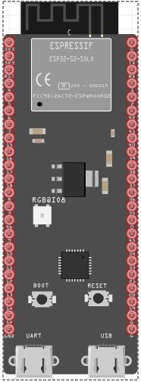
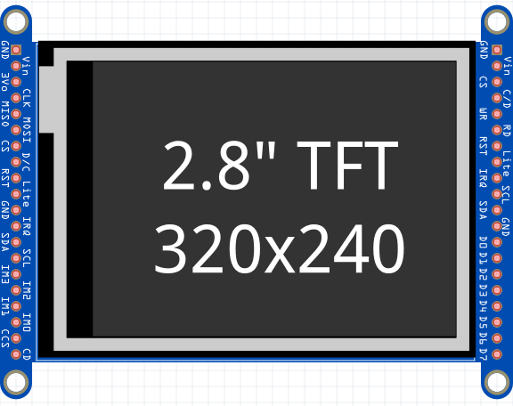
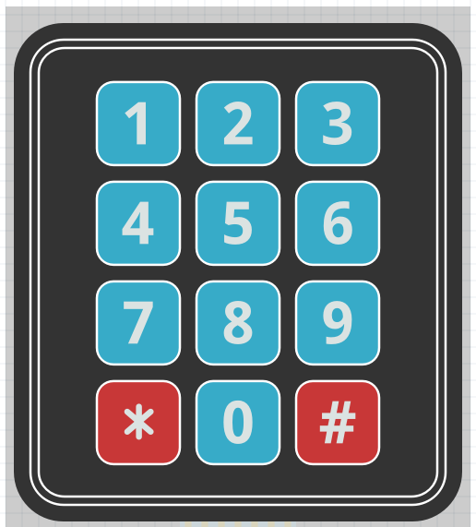
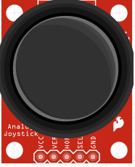
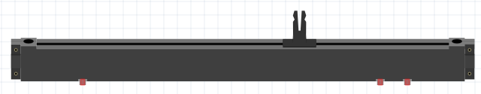
Problem Statement
User Interfaces are one of the most expensive and time-consuming part of product development and have a steep learning curve.
A plug and play panel with a start-to-finish user interface development experience
Team: Parker Sexton, Kelly Mae Allen, Will Wood, Nida Kosedagi, Abisha Fenn
Mentors: Professor Jim Carlson
System Requirements
Two wire user interface
Touchscreen Display
Interchangeable tactile buttons, knobs, and sliders
Protective enclosure
Wide MCU compatibility
Custom PCB for Main Board and Peripherals
Cost ~ $100
User Flow
User Designs Layout
Website Generates String
Device requests profile
String decoded into components
System Architecture Diagram
User
System
Website
UART
ESP 32
Design Challenges
Dynamic Code Structure
Customizability
Sharing Profile over Wifi
Refreshing Profiles on Touchscreen
Minimal/Intuitive Coding for User
Hot Swapability of I2C Components
Compatibility of Arduino Libraries
Pogo Pin Enclosure
Peripherals
Embedded System
Send output data
Draw components from website
Register input from i2c and touchscreen
Send status over UART
Receive input data
Notes:
Key Features → System Requirements

Slide 2
A plug and play panel with a start-to-finish user interface development experience
Team: Parker Sexton, Kelly Mae Allen, Will Wood, Nida Kosedagi, Abisha Fenn
Mentors: Professor Jim Carlson
Software Support
Embedded System
Draw components from website
User Designs Layout
Register input from i2c and touchscreen
Website Generates String
Device requests profile
Send output data
Receive input data
String decoded into components
Send status over UART
Notes:
Key Features → System Requirements

Slide 3
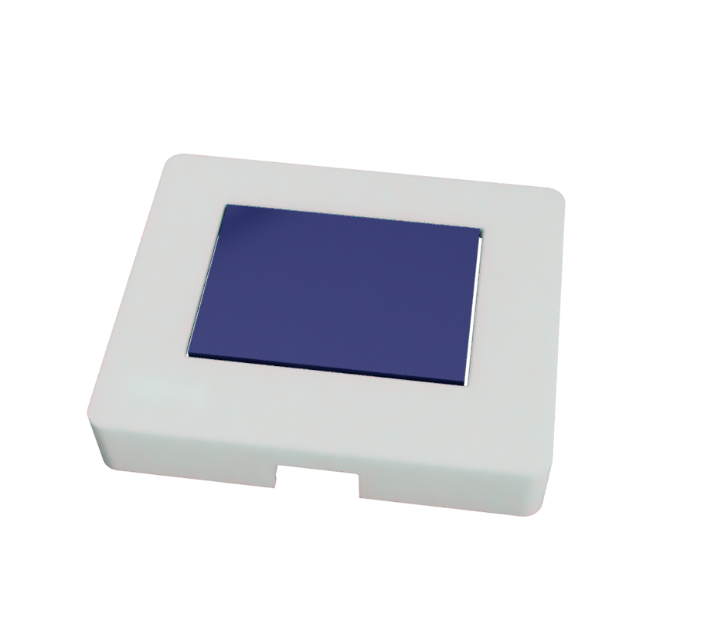
A plug and play panel with a start-to-finish user interface development experience
Team: Parker Sexton, Kelly Mae Allen, Will Wood, Nida Kosedagi, Abisha Fenn
Mentors: Professor Jim Carlson
Software Support
Embedded System
User Designs Layout
Draw components from website
Website Generates String
Register input from i2c and touchscreen
Device requests profile
Send output data
Receive input data
String decoded into components
Send status over UART
Key features
Two wire User interface (UART)
Hardware and software components
Interchangeable tactile buttons, knobs, and sliders
Protective enclosure
Wide microcontroller compatibility
One stop shop user interface development
Upcoming changes
More i2c components
Custom port design
Detailed setup guide
Robust user examples that demonstrate everything protocontrol can do

Slide 4
Team: Parker Sexton, Kelly Mae Allen, Will Wood, Nida Kosedagi, Abisha Fenn
Mentors: Professor Jim Carlson
A plug and play panel with a start-to-finish user interface development experience
Key features
UART
Touchscreen
Interchangeable tactile buttons, knobs, and sliders
Protective enclosure
Wide microcontroller compatibility
Minimal Coding Background
Custom PCB
Notes:
Problem Statement
Key Features → System Requirements (can this be part of our diagram?)
System Architecture Diagram (maybe this goes in our technical specifications)
Design Challenges

Slide 5
A plug and play panel with a start-to-finish user interface development experience
Team: Parker Sexton, Kelly Mae Allen, Will Wood, Nida Kosedagi, Abisha Fenn
Mentors: Professor Jim Carlson
Notes:
Key Features → System Requirements

Slide 6
A plug and play panel with a start-to-finish user interface development experience
Team: Parker Sexton, Kelly Mae Allen, Will Wood, Nida Kosedagi, Abisha Fenn
Mentors: Professor Jim Carlson
Software Support
Embedded System
Draw components from website
User Designs Layout
Register input from i2c and touchscreen
Website Generates String
Device requests profile
Send output data
Receive input data
String decoded into components
Send status over UART
Notes:
Key Features → System Requirements

Slide 7
Icons Resources
This template contains several packs of icons for your presentations!

Slide 8
Multi-purpose
Use the icons that best suit your needs from this wide selection and give a boost to your presentations. With them you will capture the attention of your audience right away

Slide 9
Multi-purpose
Use the icons that best suit your needs from this wide selection and give a boost to your presentations. With them you will capture the attention of your audience right away

Slide 10
Education
Take a look at our selection of education icons. Use them in your presentations and make your ideas more understandable to your audience, expressing them with this visual help

Slide 11
Education
Take a look at our selection of education icons. Use them in your presentations and make your ideas more understandable to your audience, expressing them with this visual help

Slide 12
Business
Time is money! So if you are going to make a business presentation, try to use icons to convey your ideas in a more visual way. They are known worldwide and help reduce text

Slide 13
Business
Time is money! So if you are going to make a business presentation, try to use icons to convey your ideas in a more visual way. They are known worldwide and help reduce text

Slide 14
Marketing
Make your presentation more enjoyable thanks to this icons, especially created for marketing topics. Use them to convey your message and get the attention of your audience

Slide 15
Marketing
Make your presentation more enjoyable thanks to this icons, especially created for marketing topics. Use them to convey your message and get the attention of your audience

Slide 16
Medical
Medical information doesn’t have to be tough. To help you convey your research and conclusions we have created this selection of medical icons that will give a boost to your exposition

Slide 17
Medical
Medical information doesn’t have to be tough. To help you convey your research and conclusions we have created this selection of medical icons that will give a boost to your exposition

